Slide 1
Analysis of Healthcare Cost
Interview Project

Slide 2

Introduction
The task is to analyze the clinical and financial data of patients hospitalized for a certain condition. Patients have all underwent surgery and were inpatients from 2011 to 2015 in a public hospital.
We would join the data given in different tables and find insights about the drivers of cost of care.

Slide 3
clinical_data_df
4 tables are given and we would be joining them based on the columns they share.
medical_history_1 | 3167 | preop_ medication_1 | 3400
medical_history_2 | 3400 | preop_ medication_2 | 3400
medical_history_3 | 3400 | preop_ medication_3 | 3400
medical_history_4 | 3400 | preop_ medication_4 | 3400
medical_history_5 | 3096 | preop_ medication_5 | 3400
medical_history_6 | 3400 | preop_ medication_6 | 3400
medical_history_7 | 3400 | symptom_1 | 3400
lab_result_1 | 3400 | symptom_2 | 3400
lab_result_2 | 3400 | symptom_3 | 3400
lab_result_3 | 3400 | symptom_4 | 3400
id | 3400 | symptom_5 | 3400
date of admission | 3400 | date of discharge | 3400
height | 3400 | weight | 3400
demographics_df
patient id | 3000
gender | 3000
race | 3000
resident status | 3000
date of birth | 3000
biill_id_df
biill_amount_df
patient_id | 13600
bill_id | 13600
Date of admission | 13600
bill id | 13600
amount | 13600

Slide 4
Merging the Tables
01
Column Names and values across the table have been renamed to ensure consistency in the dataset.
Renaming
02
Bill ids are matched to merge bill_id_table and bill_amount_df.
First Merge
03
There are more patients than bill ids hence the difference in entries in both files. The demographics file is matched on patient id and merged.
Second Merge
04
In the final merge, we match patient id and admission date by creating a new column combining both values. We realized one patient may have more than one admission hence there are more admissions dates than patient id. We group the patient bills in a single visit and put them into one entry. One admission entry would represent a new patient as details like age at admission would differ.
Final Merge

Slide 5
Adding on Variables
We include variables that would be useful to our analysis.
medical_history_1 | preop_ medication_1
medical_history_2 | preop_ medication_2
medical_history_3 | preop_ medication_3
medical_history_4 | preop_ medication_4
medical_history_5 | preop_ medication_5
medical_history_6 | preop_ medication_6
medical_history_7 | symptom_1
lab_result_1 | symptom_2
lab_result_2 | symptom_3
lab_result_3 | symptom_4
patient id | symptom_5
date of admission | date of discharge
height | weight
gender | race
resident_status | date_of_birth
Age at admission
BMI
Age is a health risk factor and can possibly make a difference in healthcare needs and help.
BMI take in account of height and weight and is a common health risk indicator.
05
04
03
02
01
Total Amount
Length of Stay
Average Amount
The bills are grouped so we can see the cost they spent in single visit.
A longer stay would naturally mean more bills as they accumulate
Accounting for the length of stay, we divide the amount based on their stay.

Slide 6

Analyzing Patient’s Data

Slide 7
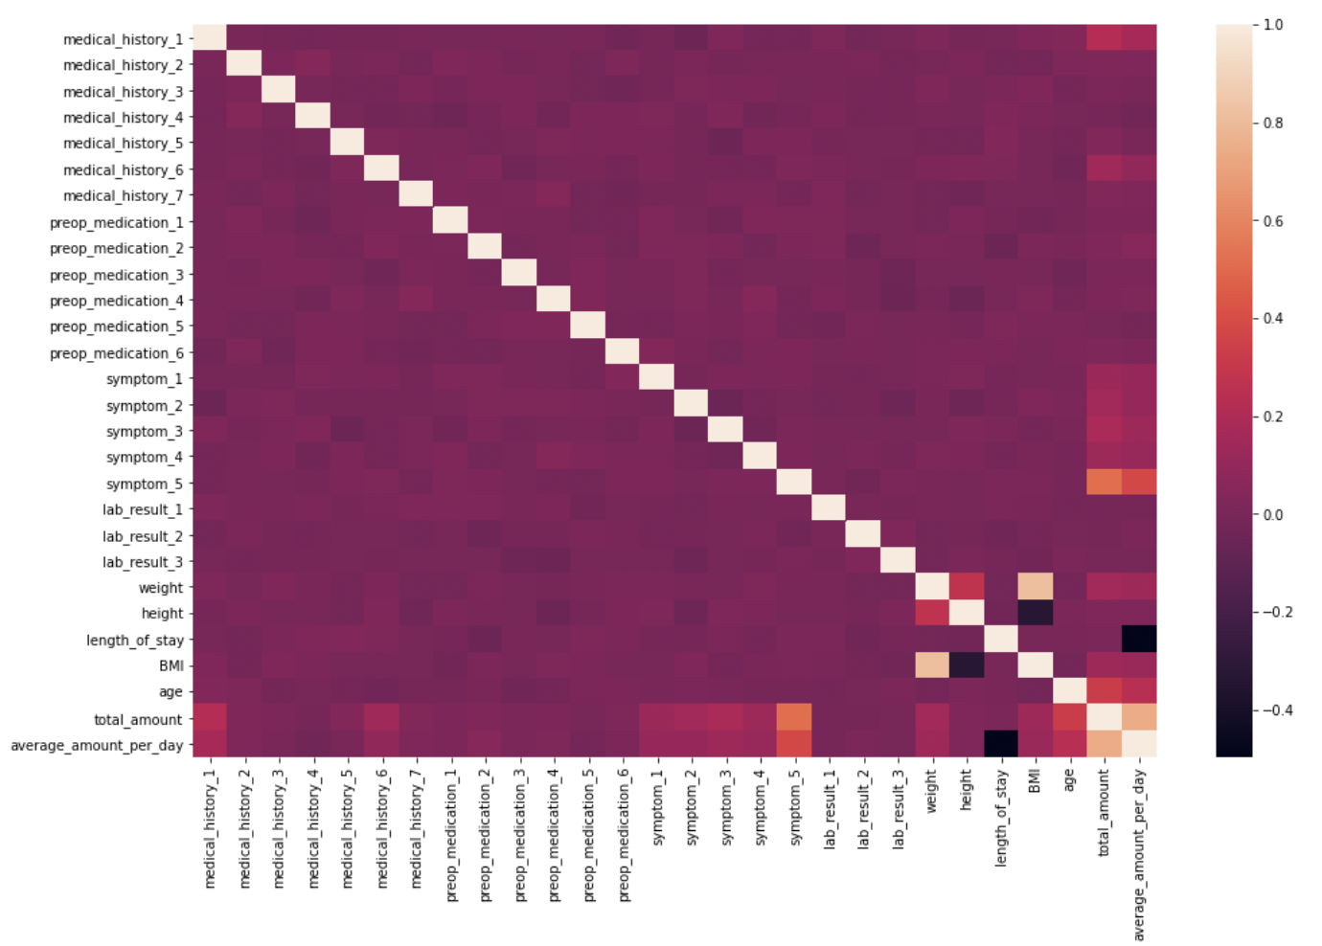
Overview
We do a correlation heatmap to have a quick look at the relationships between the variables. We observe symptom 5 has a higher correlation with cost of care.
In the following analysis, we would be looking at different variables and using average amount (total amount / length of stay) in our comparison as our cost of care.
While there are missing entries in medical history 2 and 5, entries will not be removed as it would be too costly and unless involved in mentioned variable, it would have no effect. Instead it would be predicted when needed for analysis.

Slide 8
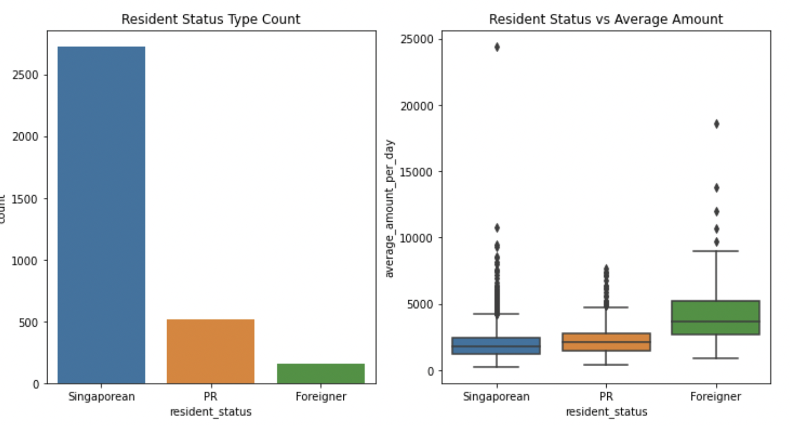
Resident Status
Foreigner
Foreigner patients has the lowest count among the three statuses but also reflects a comparatively higher cost of care. This suggest subsidies are given to the locals and PRs. It is coherent with the fact that dataset is taken from public hospital instead of private healthcare. This could become significant especially as operations incur one of the highest costs.

Slide 9
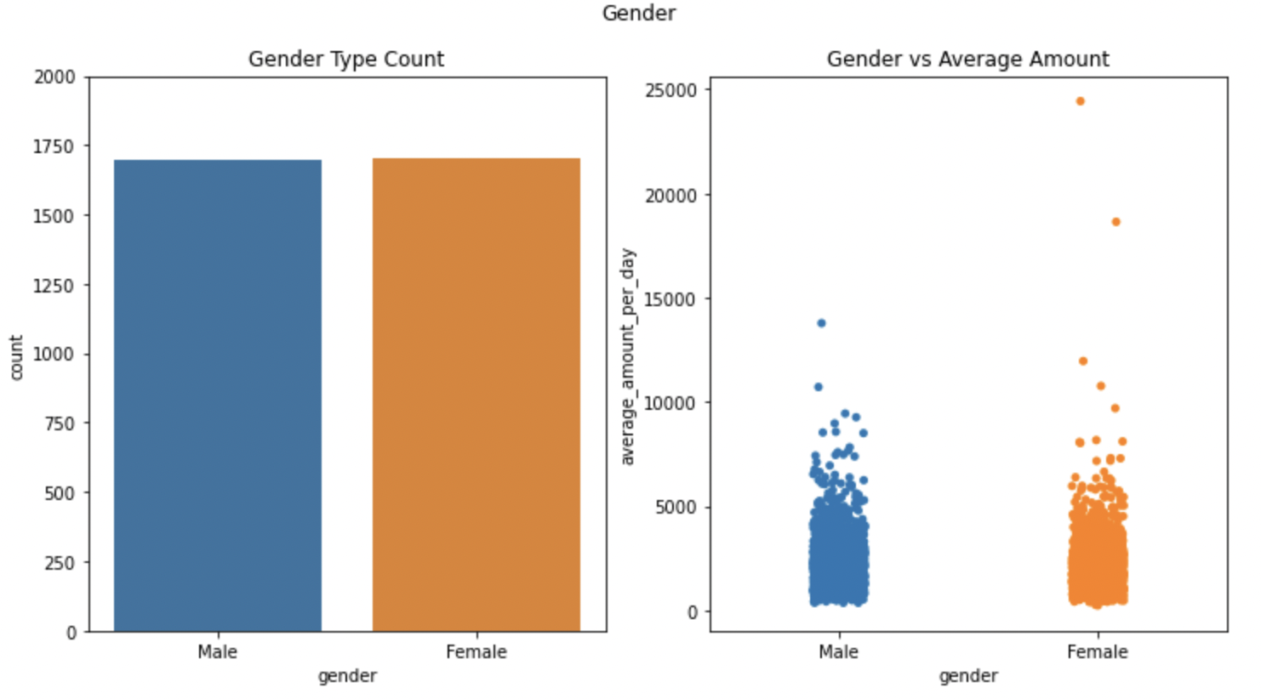
Gender
Gender
The count of Male and Female patients are rather equal. Less a few anomalies, the cost of care does not differ significantly.

Slide 10
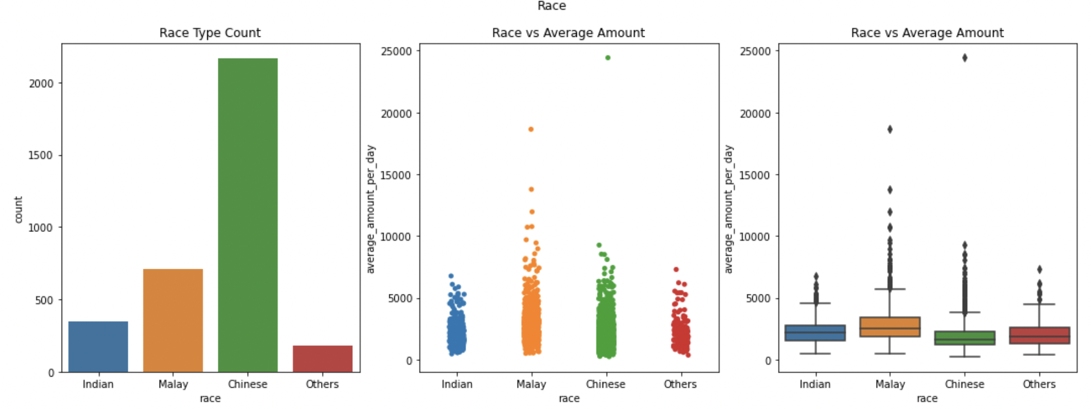
Race
Chinese has the higher counts among the 4 races, which is coherent with the proportion of Singapore race population.
Malays have a much higher cost than the other races. However, upon after conducting normalization of distribution and one-way ANOVA, we do not find this difference significant. But this may differ upon bigger sample size, so we do not neglect this factor.
Malay

Slide 11
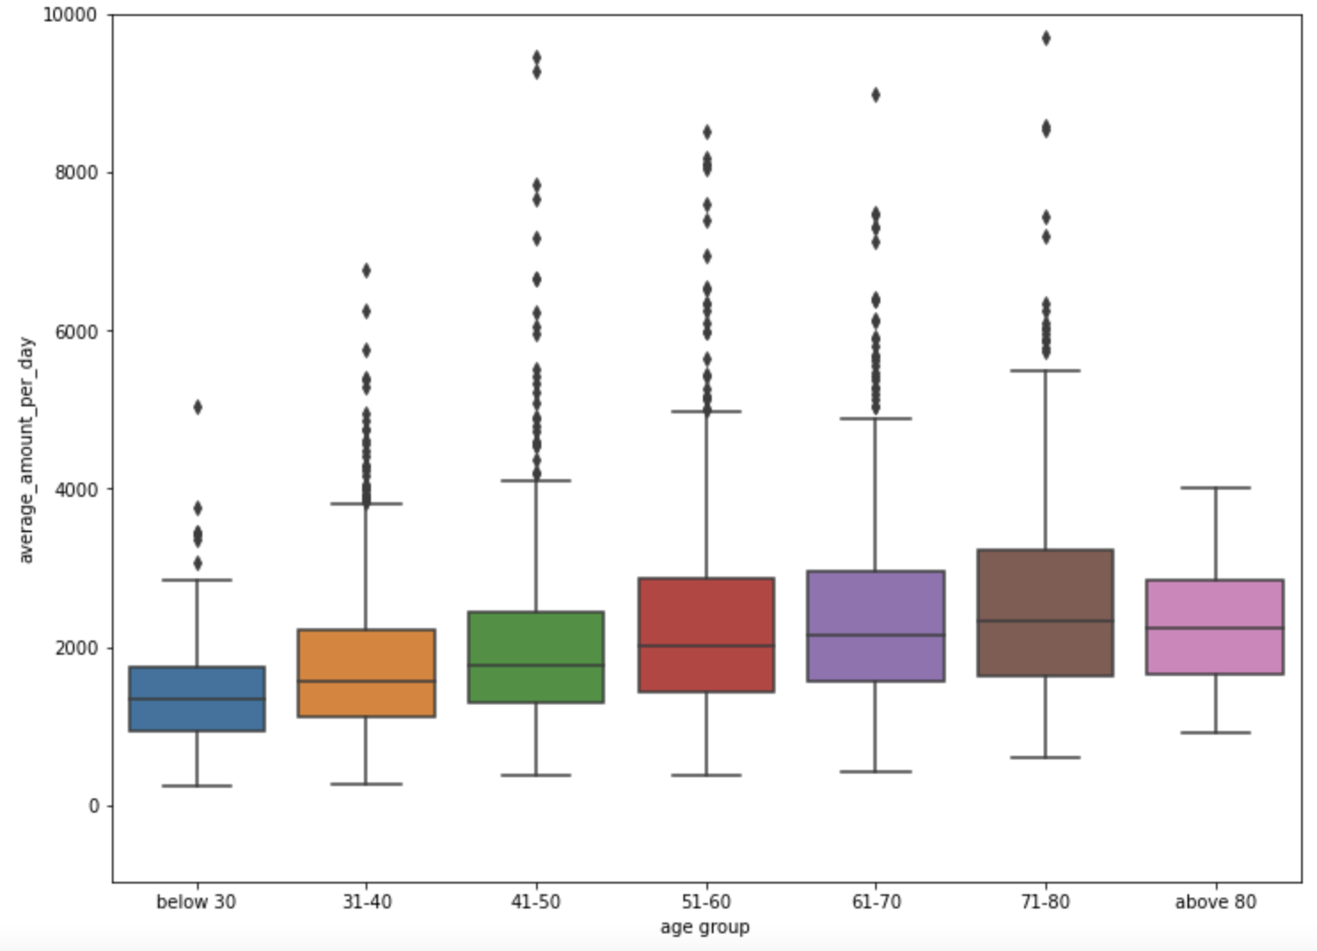
Age group
71 – 80 yrs old
We see there is general increasing trend in healthcare cost until a dip beyond age of 80.
It can arise from increasing healthcare needs due to age-related complications. The fall in cost beyond 80 could be due to the smaller sample size or additional subsidies due to age.

Slide 12
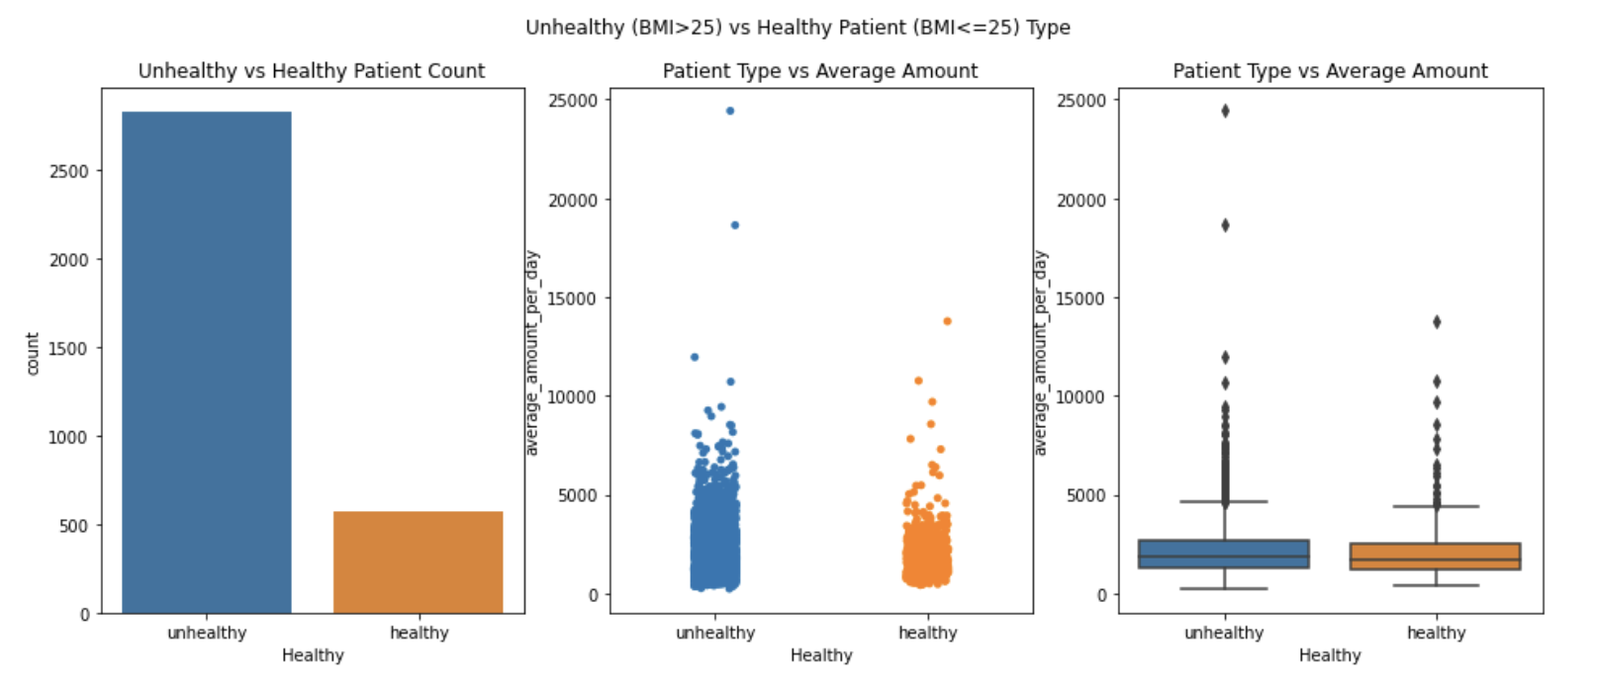
BMI (Healthy/Unhealthy)
BMI > 25
We group patients beyond BMI > 25 as unhealthy and examine the differences between the 2 groups. We observe most of the patients are considered unhealthy. The cost of care among unhealthy patients is higher than that of healthy patients.

Slide 13
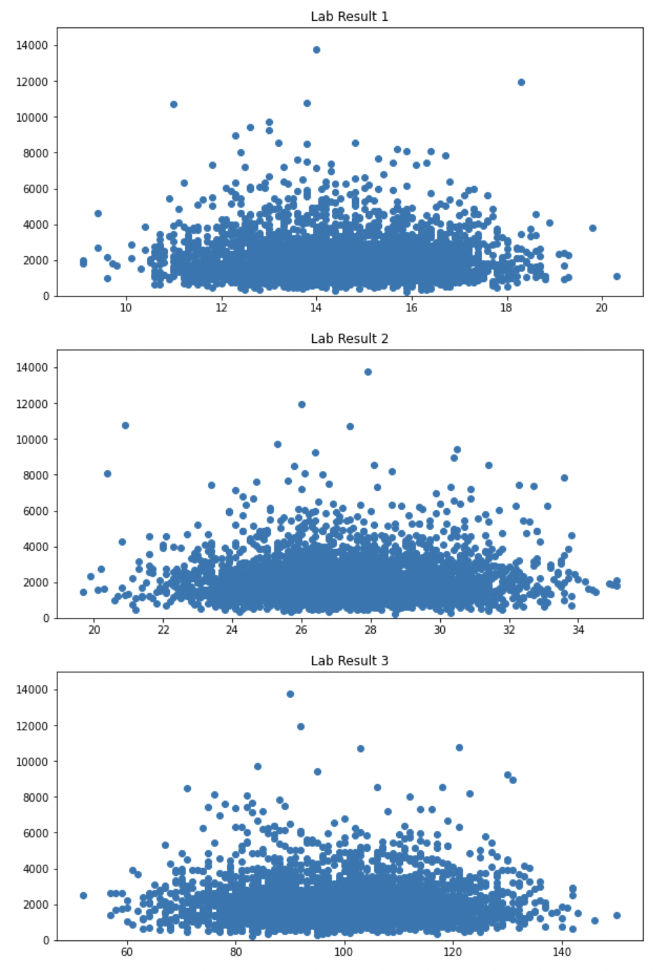
Lab Results
Two Ends of Result Spectrum
While correlations do not reflect strong relationship, we see that the lab results has a consistent pattern where the cost of care generally decreases as it approaches two ends of the lab result spectrum.

Slide 14
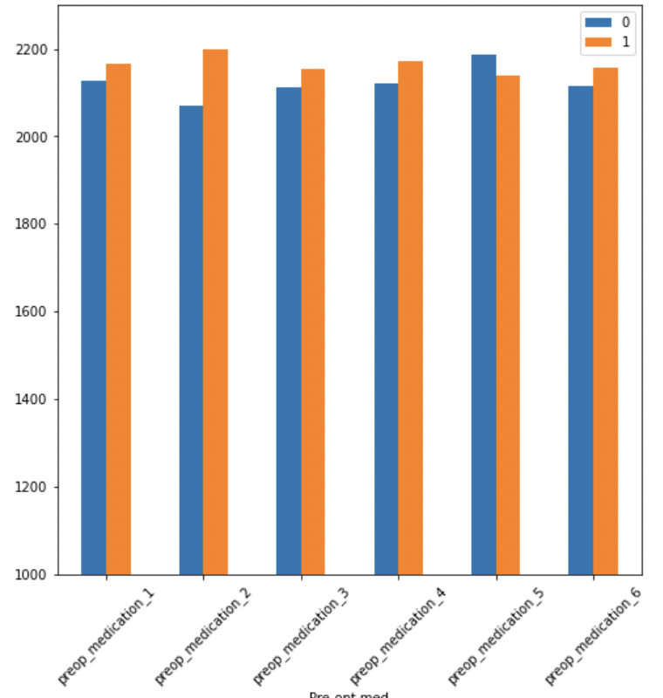
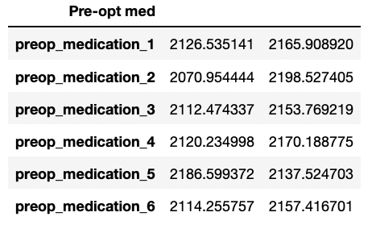
Pre-opt Medication
With or without medication
With the exception of medication 5, we see that patients generally spend more if they were taking the medication on average. However, these differences are not huge and may not be significant so we take another approach in the next few slides to see if taking medication would mean higher cost.

Slide 15
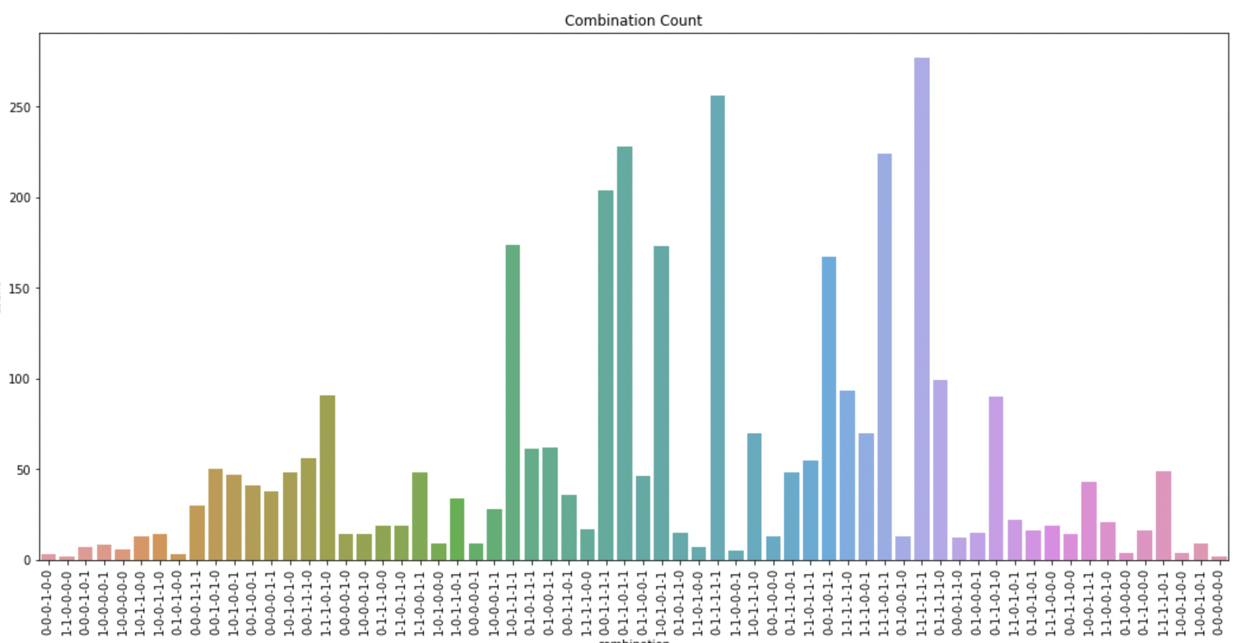
Pre-opt Medication
We examine the combination of the 6 pre-opt medication and log their respective counts. Most patients have taken all medication.

Slide 16
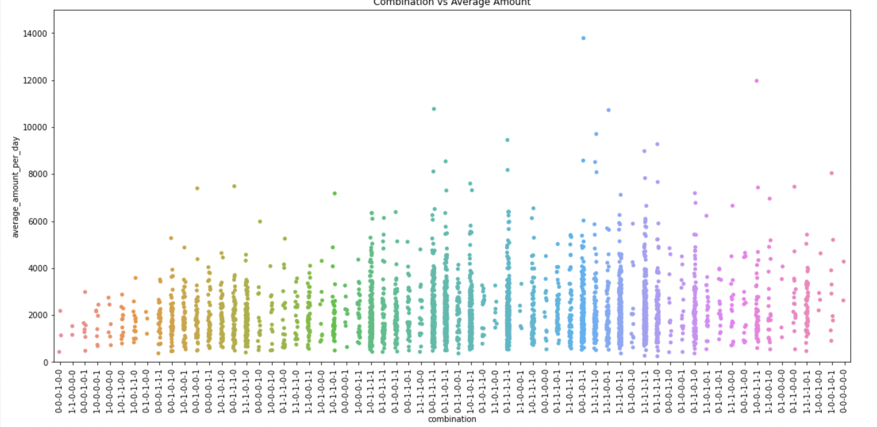
Pre-opt Medication
The chart corresponding to previous has been sorted according to mean cost of care. We can see even if a patient has taken all medication, it can have similar cost patterns to other combinations and would not mean the highest cost.
Pre-opt medication could have been used to control possible complications after operation and hence saving the potential cost.

Slide 17
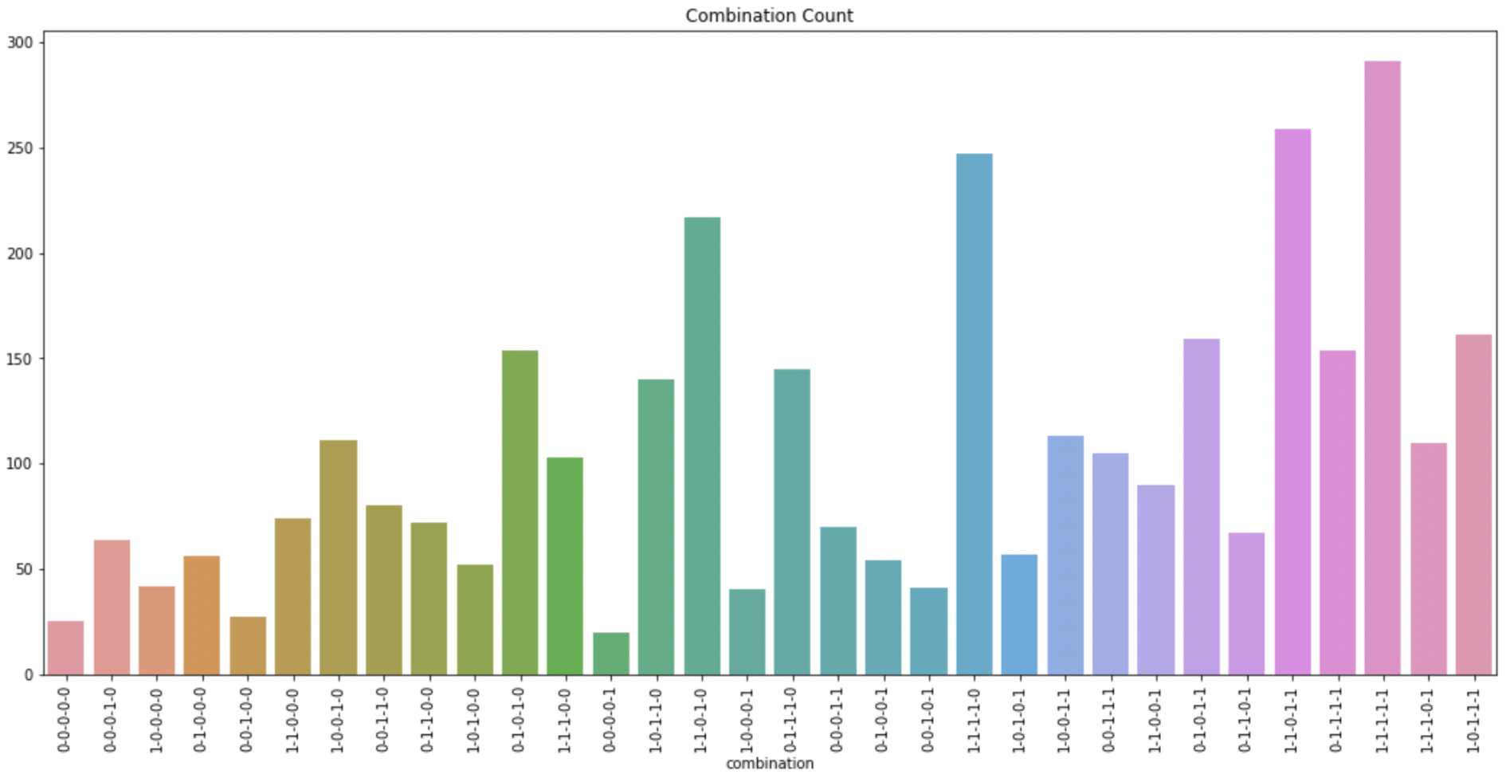
Symptoms
A similar graph is done on the symptoms and we ran the counts for the combination of symptoms and find that majority of the patients have all the symptoms.

Slide 18
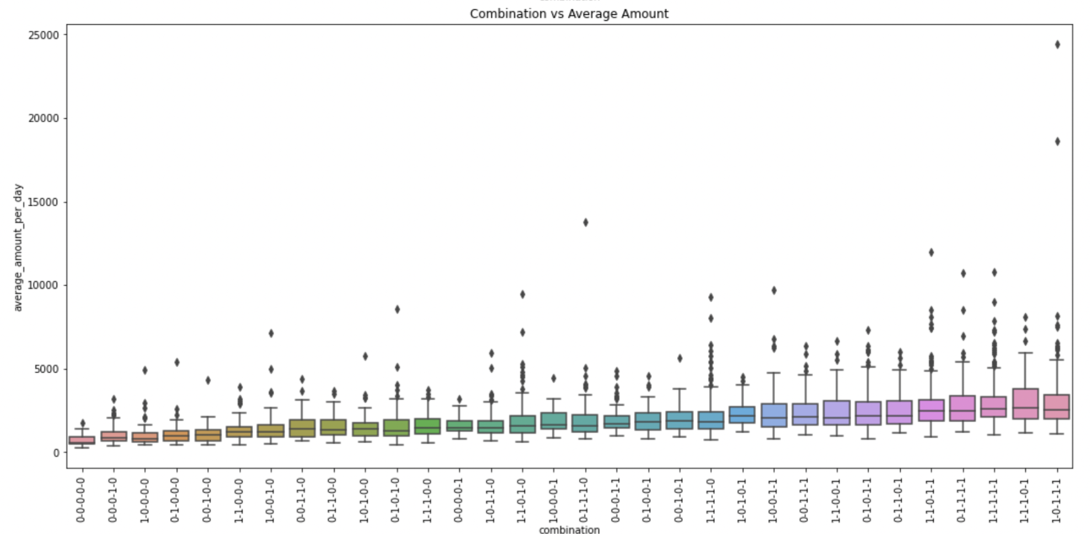
Symptoms
Combinations are put in ascending order based on the cost of care. Recalling in our correlation heatmap, symptom 5 was found to have higher correlation and this is reflected here whereby combinations containing symptom 5 have higher cost of care and hence further down in the x-axis.
However, we also see having all symptoms may not entail highest cost of care. This could mean some symptoms more easily controlled than some.

Slide 19
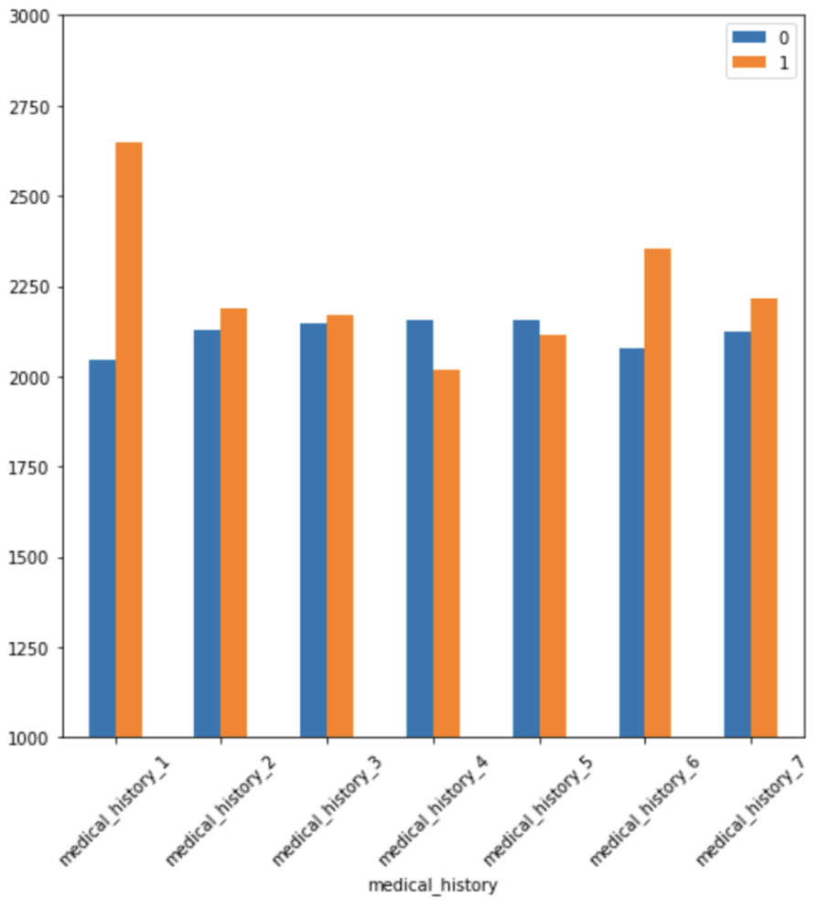
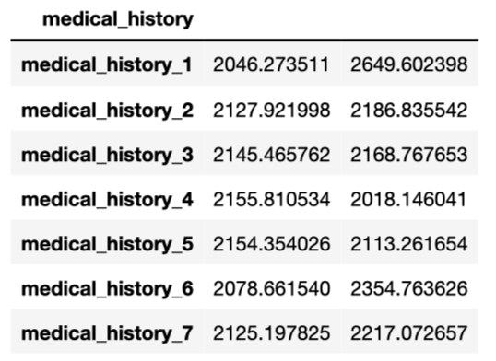
Medical History
We fill in missing entries for medical history 2 and 5 and removed entries whereby both are missing (35 out of 3400) since it is not too costly. We evaluated some models and used log regression model to predict the missing values.
With or without medical history
Interestingly, medical history 4 and 5 reflect lower cost of care while others reflect higher cost of care in the presence especially medical history 1. As it is not feasible to look at the combinations (144), we would instead look at how medical history fare in comparison to other variables.

Slide 20
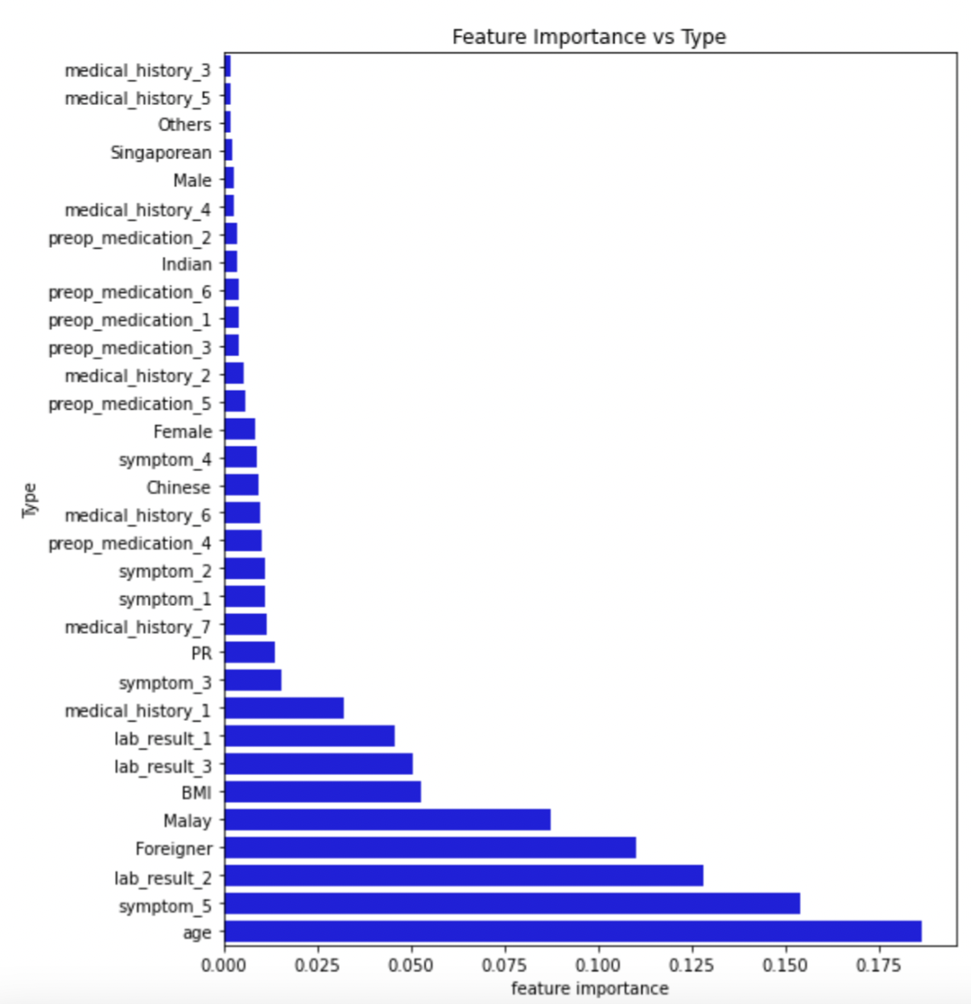
Medical History
Medical History
We used Decision tree regressor to examine the relative feature importance of the variables.
Consistent with previous chart, we see medical history 1 plays a larger role among all medical histories. This is followed medical history 6 and 7. However we can see their impact is relatively smaller than other variables.

Slide 21
Medical History
Features Importance
Age
Age is shown to have largest influence on increased cost, but it also falls beyond age group of 80.
Symptom 5
Having symptom 5 could entail more care such as tests and medications or complicated treatments as it is consistently prominent in the analysis.
Malay / Foreigner / BMI
These three factors have been found to have higher cost of care as in the previous analysis.
Lab results
Lab results have relatively higher importance to other factors, especially lab result 2. Cost would fall when it approaches either end of the lab results.

Slide 22
Conclusions
Through combination of factors, we can better predict what drives the cost of healthcare.
From the dataset, we can see that generally patients who pay more have older age, Malay as race, foreigner status, symptom 5, unhealthy BMI and mid-range lab results but less regard of gender or requiring pre-op medication.

